Slide 1
Title Layout
Subtitle

Slide 2
Title and Content Layout with List
Add your first bullet point here
Add your second bullet point here
Add your third bullet point here

Slide 3
Title and Content Layout with Chart

Slide 4
Two Content Layout with Table
First bullet point here
Second bullet point here
Third bullet point here
Class | Group A | Group B
Class 1 | 82 | 95
Class 2 | 76 | 88
Class 3 | 84 | 90

Slide 5
Two Content Layout with SmartArt
First bullet point here
Second bullet point here
Third bullet point here
Group A
Task 1
Task 2
Task 3

Slide 6
Add a Slide Title - 1

Slide 7
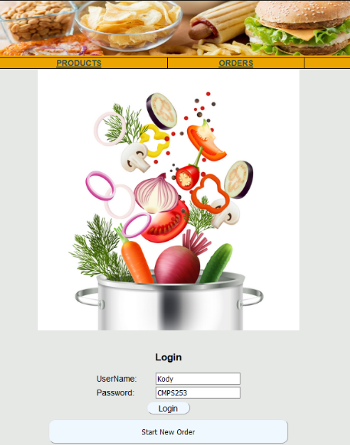
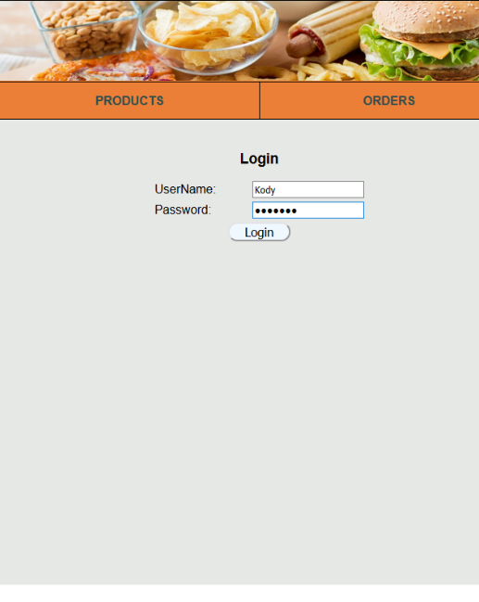
Prototype Version 1 vs. Prototype Version 2
Old Home Page
New Home Page
Notes:
The old home page had a giant image on the middle of the page which made it so that the login fields were at the bottom of the page. Also, the password field in the login wasn’t hiding the input text which was a security flaw, and the “Start New Order” button appeared BEFORE the user was logged in.
In the new version of the page, the giant image was removed, which brought the login fields up to the top of the page. The password field is hidden, and the “Start New Order” button only appears once the user logs in.

Slide 8
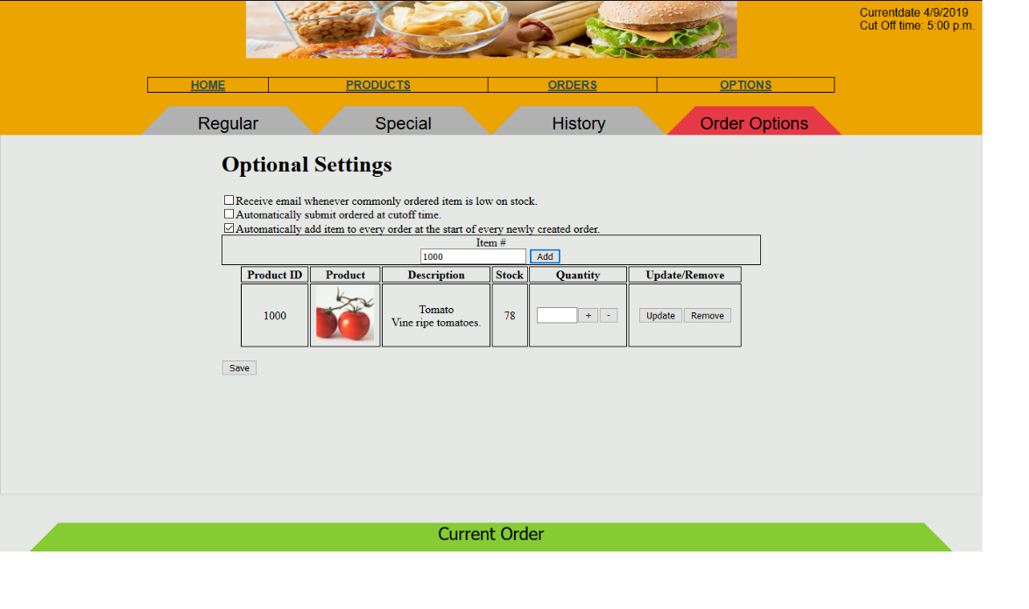
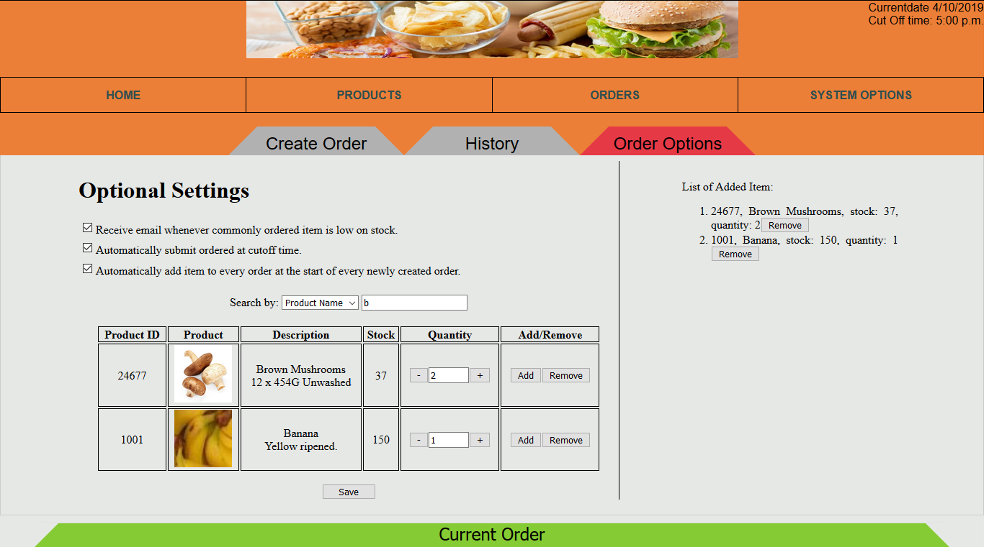
Prototype Version 1 vs. Prototype Version 2
Old Order Options Page
New Order Options Page
Get from Nguyen
Notes:
In the old Order Options page, the user was required to enter in the exact item # of a product in order to add it the order list.
We found that this was relying too much on user’s memory. In the new version, the user can type in the product ID, product name, or description, and search results will appear even for partial matches of the name.
Additionally, in the new version there is now a list on the side of the screen that shows a complete list of which products will be added automatically to every created order.

Slide 9
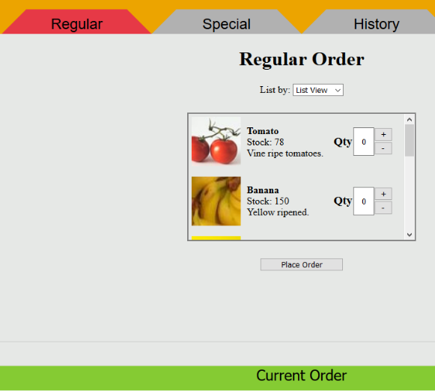
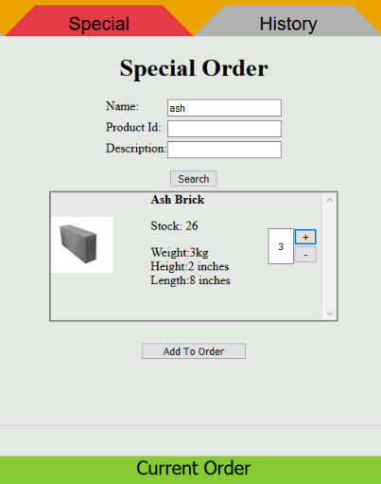
Prototype Version 1 vs. Prototype Version 2
Old Regular Order Page
Old Special Order Page
Notes:
In the previous prototype, the ordering process was split into two pages: Regular and Special. The Regular order page was designed for making a product order that would be ordered regularly by a business.
The Special Order page was made to search for an item that wasn’t in the regular product list and would have to be brought in with a custom order.

Slide 10
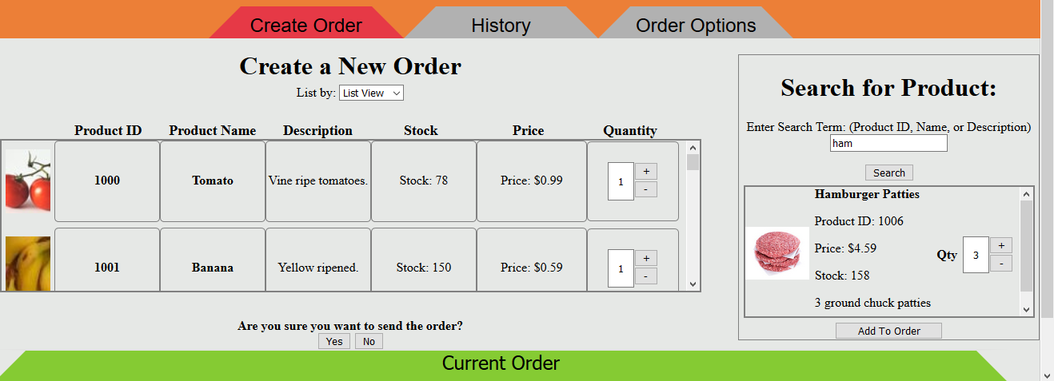
Prototype Version 1 vs. Prototype Version 2
New “Create Order” page
Notes:
In the new version of the system, the “Regular” and “Special” order pages are combined into one “Create Order” page, so that the user doesn’t have to switch back and forth between pages.
The pricing information is displayed for each product in the list view and also in the search box, and products are ordered by product ID in the List View.
The new version also has searching by keyword, which means that you don’t have to specifically choose which criteria to search to by. There is also a confirmation before the order is sent, so it’s not sent accidentally.

Slide 11
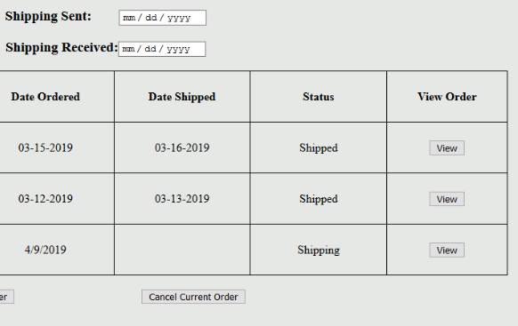
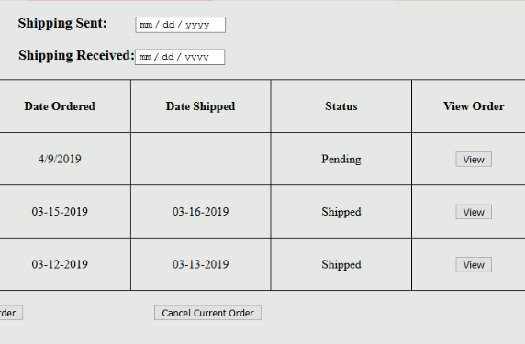
Prototype Version 1 vs. Prototype Version 2
Old Order History Page
New Order History Page
Notes:
On the “Order History” page, the current status of a single order in the list was updated from the previous version to show “Pending” instead of “Shipping” to more accurately reflect the state of the order.

Slide 12
Future Considerations
Add functionality to System Options.
Add support options for the user (phone number to call, email)
Make the system responsive.
Add functionality so that an item can be automatically ordered without sending an order manually.

Slide 14
Add a Slide Title - 5

